Slide 1

ALTA Wireless Advanced Vibration Meter

Slide 2
Introduction
The ALTA Wireless Advanced Vibration Meter uses an accelerometer to measure vibration and frequency on 3 axes.
The sensor reports vibration (acceleration, velocity, displacement, or acceleration peak), frequency (Hz/RPM), and crest factor on all three axes, and duty cycle (how much of the report interval was vibration present), and temperature.
This sensor can be used to manage vibration in assembly lines and monitor seismic activity in bridges.

Slide 3
Features
Wireless range of 1,200+ feet through 12+ walls
Frequency-Hopping Spread Spectrum (FHSS)
Improved interference immunity
Improved power management for longer battery life
Encrypt-RF® Security (Diffie-Hellman Key Exchange + AES-128 CBC for sensor data messages)
Onboard data memory stores up to 512 readings per sensor: ? 10-minute heartbeats = 22 days ? 2-hour heartbeats = 266 days
Over-the-air updates (future proof)
Free iMonnit basic online wireless sensor monitoring and notification system to configure sensors, view data and set alerts via SMS text and email

Slide 4
Example Applications
Vibration monitoring
Smart machines, smart structures & smart materials
Bridge and building seismic activity monitoring
Assembly line monitoring
Many additional applications

Slide 5
Order of Operations
Create iMonnit Account (If new user).
Register all sensors and gateways to a network in iMonnit. Sensors can only communicate with gateways on the same iMonnit network.
Connect/power on gateway and wait till it checks into iMonnit.
Power on sensor and verify it checks into iMonnit. We recommend powering the sensor on near the gateway then moving to the installation location, checking signal strength along the way.
Configure sensor for use (This can be done at any point after step 2).
Install sensor in final location.

Slide 6
Setup and Installation
Step 1:
Add the sensor on iMonnit. Add the sensor to your account by choosing Sensors in the main menu. Navigate to the Add Sensor button.
. Find the device ID. The Device ID (ID) and Security Code (SC) are necessary to add a sensor. These can both be located on the label on the side of your device.
Adding your device. You will need to enter the Device ID and the Security Code from your Sensor in the corresponding text boxes. Use the camera on your smartphone to scan the QR code on your device.
If you do not have a camera on your phone, or the system is not accepting the QR code, you may enter the Device ID and Security Code manually.
The Device ID is a unique number located on each device label. Next, you’ll be asked to enter the Security Code from your device. A security code consists of letters and must be entered in upper case (no numbers). It can also be found on the barcode label of your device.
When completed, select the Add Device button.

Slide 7
Setup and Installation
Step 2: Setup
Select your use case. Choose from the list or create your own custom settings. You will see the heartbeat interval, and aware state settings. Select the Skip button when completed.
Step 3: Validation
Check your signal. The validation checklist will help you ensure your sensor is communicating with the gateway properly and you have a strong signal.
Step 4: Actions
Choose your actions. Actions are the alerts that will be sent to your phone or email in the event of an emergency.

Slide 8
Setting Up Meter
ALTA commercial sensors are powered by AA batteries. Industrial sensors need a 3.6V Lithium battery supplied from Monnit or another industrial battery supplier.
AA meter offer both leaded and non-leaded options. Batteries are installed the same way on both models.
Leaded: The leaded model of the advanced vibration meter comes with a cube linked directly to the sensor by a long cord.
The cube enables it easier to slip inside machinery for closer monitoring of processes.
Non- Leaded: The non-leaded model does not have a cube. While the leaded version can sit a bit outside, the non-leaded model should be installed directly on, in, or under, the application being monitored to gather accurate readings.

Slide 9
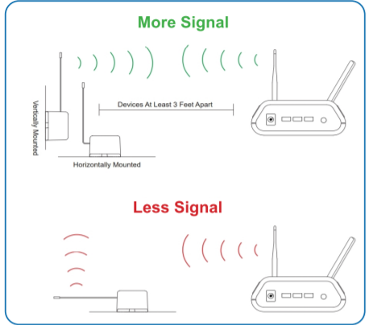
Setting Up Meter
In order to get the best performance out of your ALTA Wireless Sensors, it is important to note proper antenna orientation and sensor positioning. Antennas should all be oriented in the same direction, pointing vertically from the sensor.
If the sensor is mounted flat on its back on a horizontal surface, you should bend the antenna as close to the sensor housing as possible giving you the most amount of antenna pointing vertical.
You should make the antenna wire as straight as possible, avoiding any kinks and curving of the wire. Sensors must be at least 3 ft. away from other sensors and the wireless gateway to function.

Slide 10

Sensor Overview In iMONNIT
Select Sensors from the main navigation menu on iMonnit to access the sensor overview page and begin making adjustments to your Advanced Vibration Meter.
A. Details - Displays a graph of recent sensor data.
B. History - List of all past heartbeats and readings.
C. Events - List of all events attached to this sensor.
D. Settings - Editable levels for your sensor.
E. Scale - Set the scale your sensor will take readings at
Directly under the tab bar is an overview of your sensor. This allows you to see the signal strength and the battery level of the selected sensor. A coloured dot in the left corner of the sensor icon denotes its status.
Green indicates the sensor is checking in and within user-defined safe parameters.
Red indicates the sensor has met or exceeded a user-defined threshold or triggered event.
Grey indicates that no sensor readings are being recorded, rendering the sensor inactive.
Yellow indicates that the sensor reading is out of date, due to perhaps a missed heartbeat check-in.

